Slide 1


KIET GROUP OF INSTITUTIONS GHAZIABAD, UTTAR PRADESH (Affiliated to Dr A. P. J. Abdul Kalam Technical University, Lucknow) Department of Computer Science Session 2024-25
Nemo : Intelligent Fish Species Identification & Insights
Project ID :- PCS25-54
Team Members:-
Manvendra Singh (2100290120102)
Sarthak Tyagi (1900290120102)
Prince Yadav (2100290120129)
Udit Sharma (2100290120177)
Guided by:-
Prof. Sreesh Gaur

Slide 2
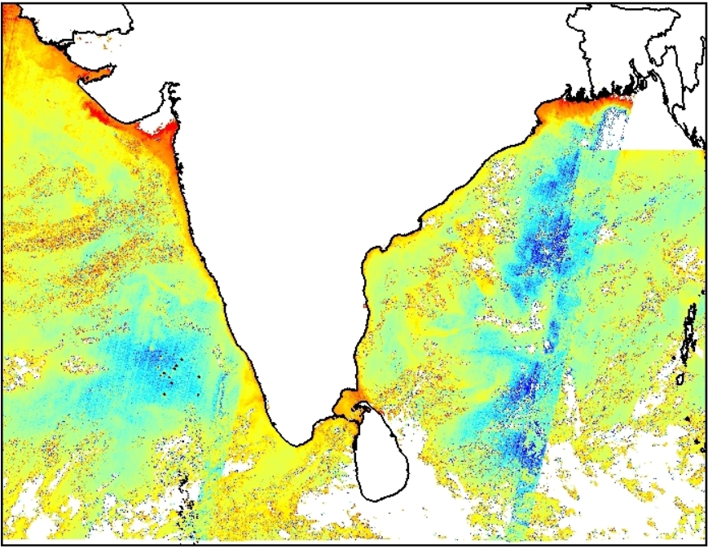
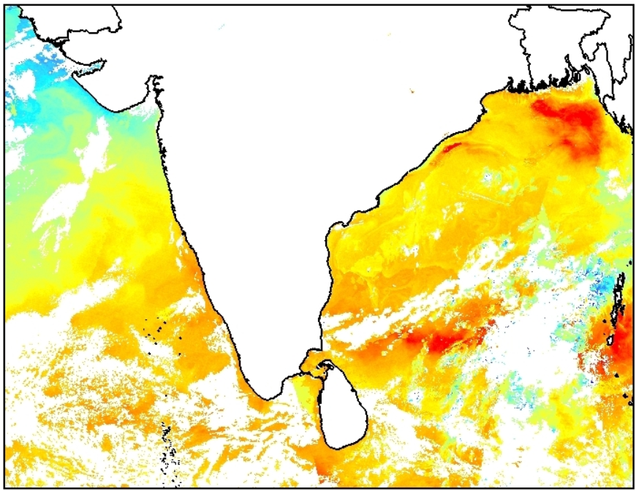
Problem Statement
Indian National Centre for Ocean Information Services ( INCOIS ), under Ministry of Earth Sciences (MoES), is providing Marine Fishery Advisory Services to the fishermen. To evaluate its accuracy and in order to develop species-specific advisories it is necessary to collect the fish-catch information at the species level. While fisherfolk are supportive to these efforts, often species level catch reporting is having hinderances due to several reasons pertaining to manual efforts which results to low or erroneous reporting.
We will be developing AI-ML based tool for image-based identification of fish-species found in the Indian seas. The images of fishes may be taken from online image searches. INCOIS will be able to use this for its fishermen feedback app, where fishermen need to take a photo of fishes caught and fish-identification will be done through code, minimizing the manual intervention.
Source:- https://incois.gov.in/MarineFisheries/PfzAdvisory

Slide 3
Project Goals and Objectives
Figure: Chlorophyll Image retrieved from Oceansat-2 Satellite Data
Figure: Sea Surface Temperature (SST) Image retrieved from AVHRR
Source:- https://incois.gov.in/MarineFisheries/PfzAdvisory

Slide 4
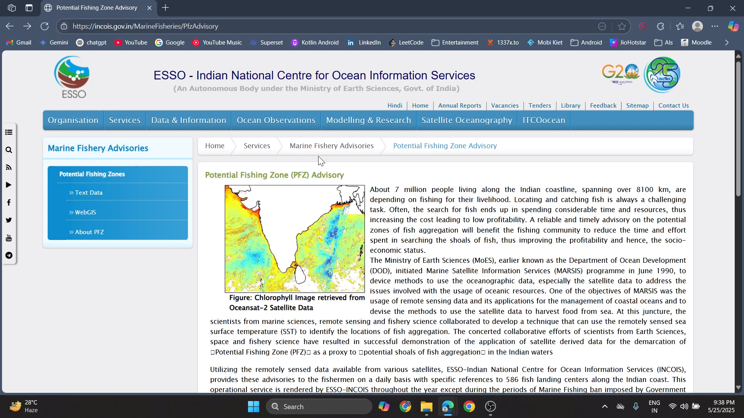

Slide 5

Project Goals and Objectives
🎯 Goals (Broad Vision)
To develop an ML-based mobile application for automatic fish species identification.
To assist researchers, fishermen, and enthusiasts in identifying fish species in real-time.
To contribute to marine biodiversity monitoring and conservation.
🎯 Objectives (Measurable Targets)
Build a clean dataset of various fish species, applying background removal and augmentation.
Train multiple deep learning model for species classification.
Deploy the best model in an Android application with camera/image upload functionality.
Store captured data and user history in Firebase for future analysis.
Include extra features like fish info, Wikipedia links, and user profiles.

Slide 6
Alignment with UN Sustainable Development Goals (SDGs)
SDG 14 : Life Below Water
It directly supports the sustainable use of marine resources by providing tools to accurately identify fish species. This can enhance species-specific advisory services and promote responsible fishing practices, ultimately aiding in the conservation of marine ecosystems.
Target 14.4: By 2020, effectively regulate harvesting and end overfishing, illegal, unreported, and unregulated fishing, and destructive fishing practices and implement science-based management plans.
SDG 2 : Zero Hunger
By identifying fish species and providing nutritional information, our app contributes to better utilization of marine resources for food security and improved nutrition. It helps fishermen make informed decisions, enhancing their livelihoods and ensuring sustainable food sources.
Target 2.4: Ensure sustainable food production systems and resilient agricultural practices that increase productivity and production.

Slide 7
Alignment with UN Sustainable Development Goals (SDGs)
SDG 9 : Industry, Innovation, and Infrastructure
Our project incorporates advanced AI-ML techniques and develops an innovative application for the fishing industry. This promotes the use of technology to modernize traditional practices, bridging the gap between technology and fisheries.
Target 9.5: Enhance scientific research, upgrade technological capabilities, and foster innovation in developing regions.
SDG 13 : Climate Action
By integrating weather conditions and geographic data in our app, the project supports climate-resilient practices for fishermen. It indirectly helps mitigate the impact of climate change on marine biodiversity by encouraging sustainable practices.
Target 13.3: Improve education, awareness-raising, and human and institutional capacity on climate change mitigation, adaptation, impact reduction, and early warning.

Slide 8

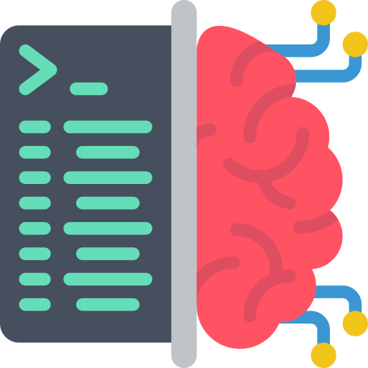
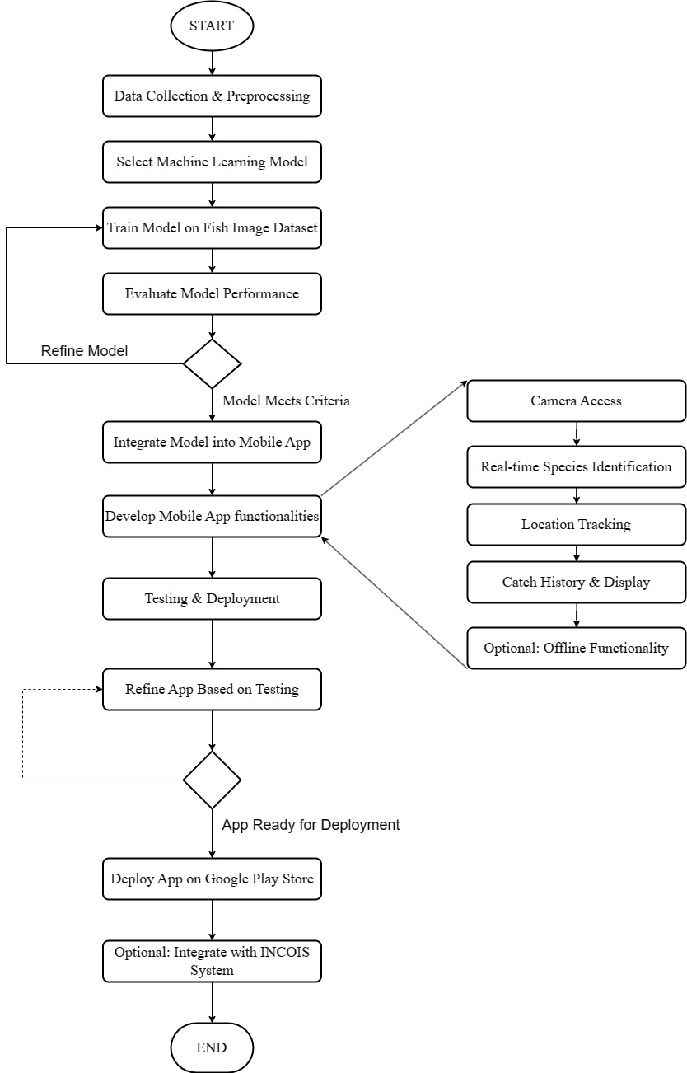
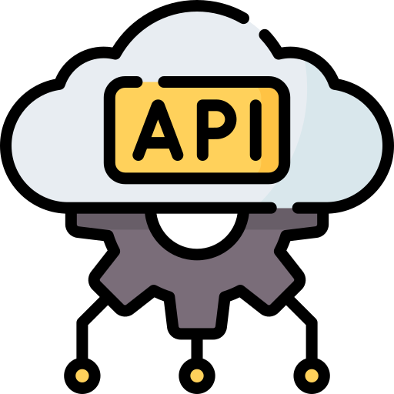

🛠️ Technology Used
Machine Learning
Frontend (Android App)
TensorFlow & Keras
For training fish classification models
Kotlin
Main Programming language
Albumentations
For dataset augmentation
UI Design
XML-based layouts
Data Collection and Preprocessing
TFLite
Deploying ML models on Android
Machine Learning Model Development
Mobile App Development
Integrating Model into Mobile App
Testing and Deployment
APIs & Tools
Backend & Storage
Retrofit
For making HTTP network requests
Firebase Authentication
User login (Email/Google Sign-In)
Rembg
For background removal during dataset preparation
Firebase Firestore
Cloud NoSQL database to store user data and history
Firebase Storage
To store profile pictures and captured fish images
Google Colab / Jupyter
Used for model training and evaluation

Slide 9
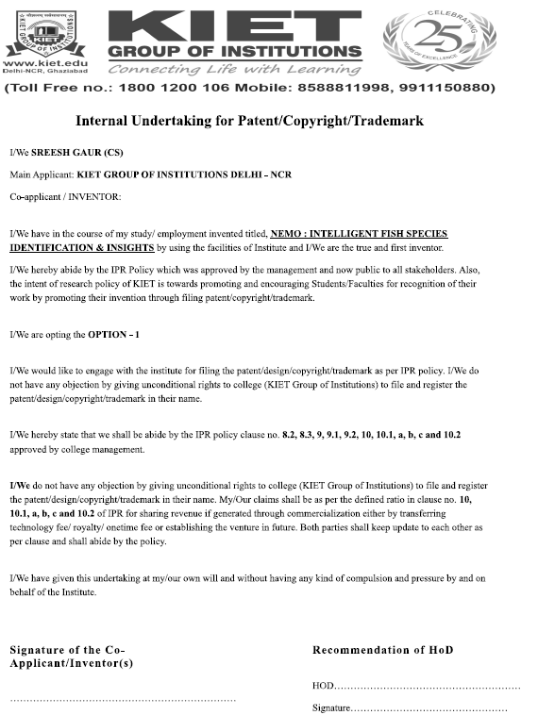
Workflow Diagram
Data Collection and Preprocessing
Machine Learning Model Development
Mobile App Development
Integrating Model into Mobile App
Testing and Deployment

Slide 10
Patent
Data Collection and Preprocessing
Machine Learning Model Development
Mobile App Development
( Published )
Integrating Model into Mobile App
Testing and Deployment

Slide 11
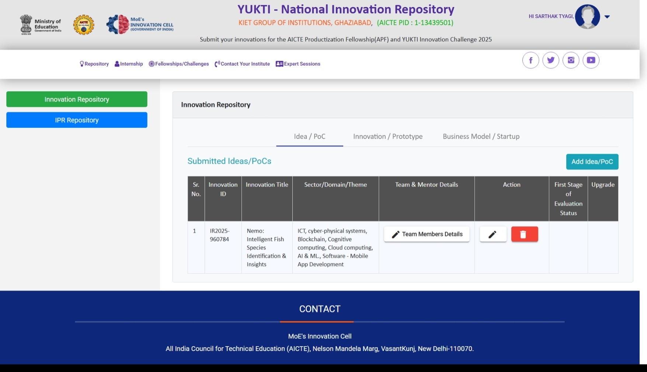
YUKTI Portal
Data Collection and Preprocessing
Machine Learning Model Development
Mobile App Development
Integrating Model into Mobile App
Testing and Deployment

Slide 12
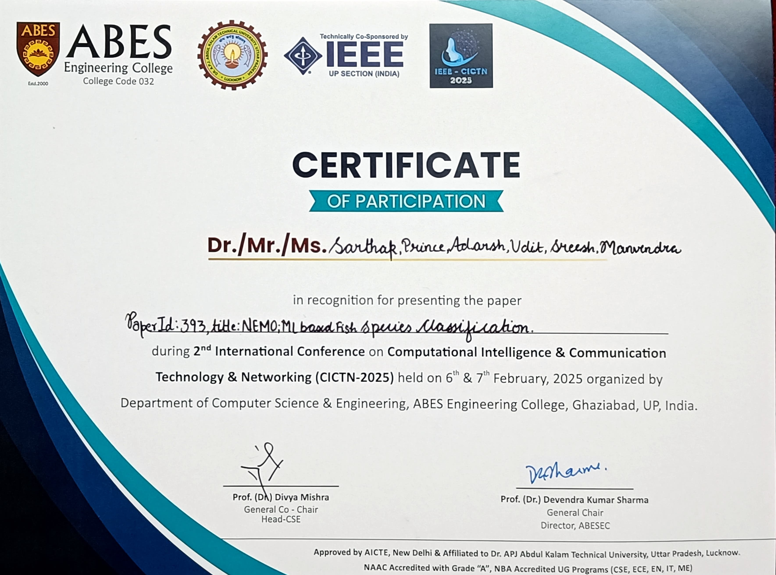
Research Paper (Published)
Title of the Paper: Nemo: ML Based Fish Species Classification
Conference: 2025 2nd International Conference on Computational Intelligence,
Communication Technology and Networking (CICTN)
Authors: M. Singh, S. Gaur, S. Tyagi, U. Sharma, P. Yadav and A. Mishra
Pages: 461–467
DOI: 10.1109/CICTN64563.2025.10932485
Publisher: IEEE
Indexing: IEEE Xplore, Scopus
Date of Conference: 06-07 February 2025
Date Added to IEEE Xplore: 26 March 2025
Data Collection and Preprocessing
Machine Learning Model Development
Mobile App Development
Integrating Model into Mobile App
Testing and Deployment

Slide 13
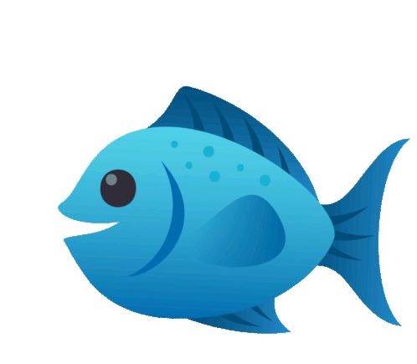
Here is
DEMO
Source : Fish Joypixels Sticker - Fish Joypixels Underwater Living - Discover & Share GIFs

Slide 14
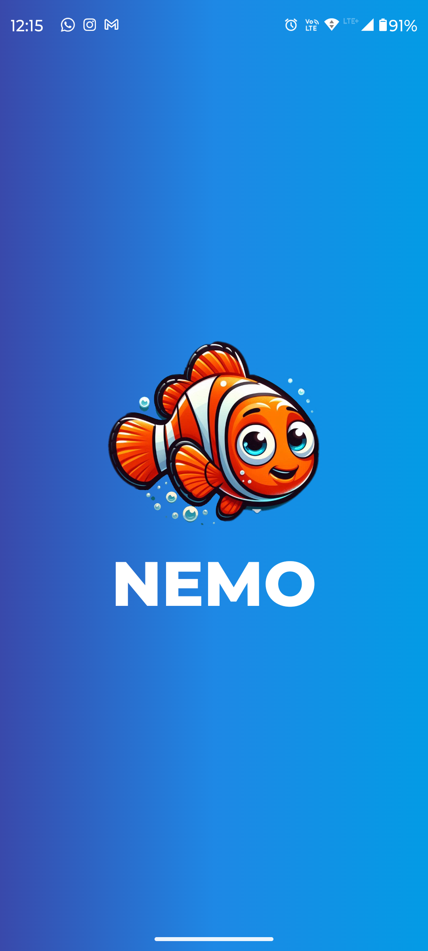
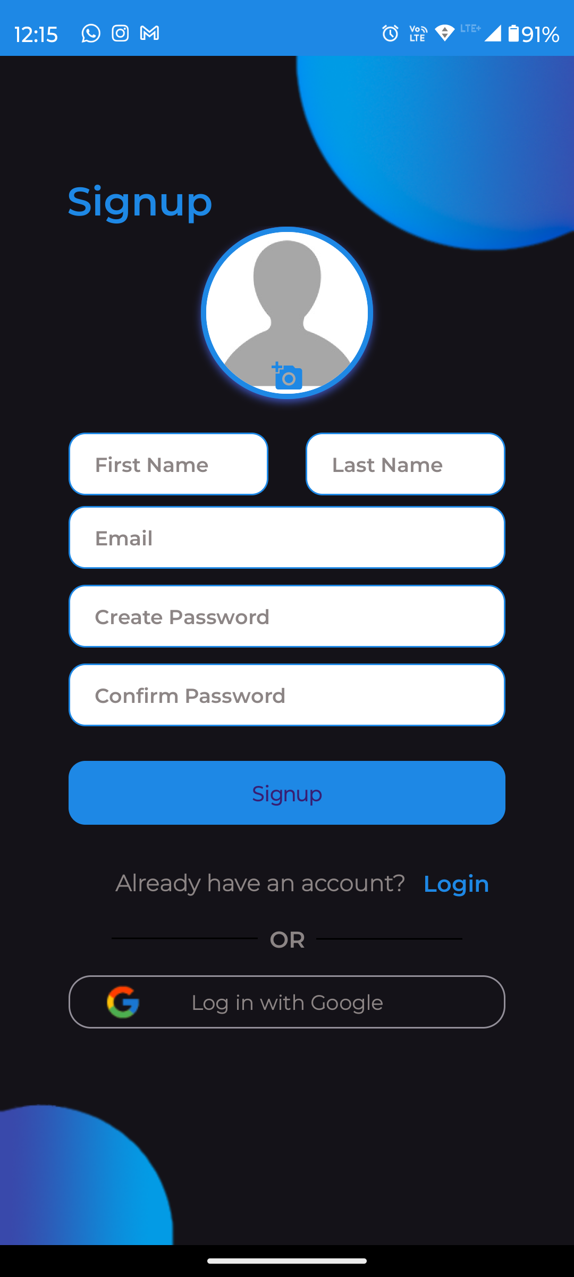
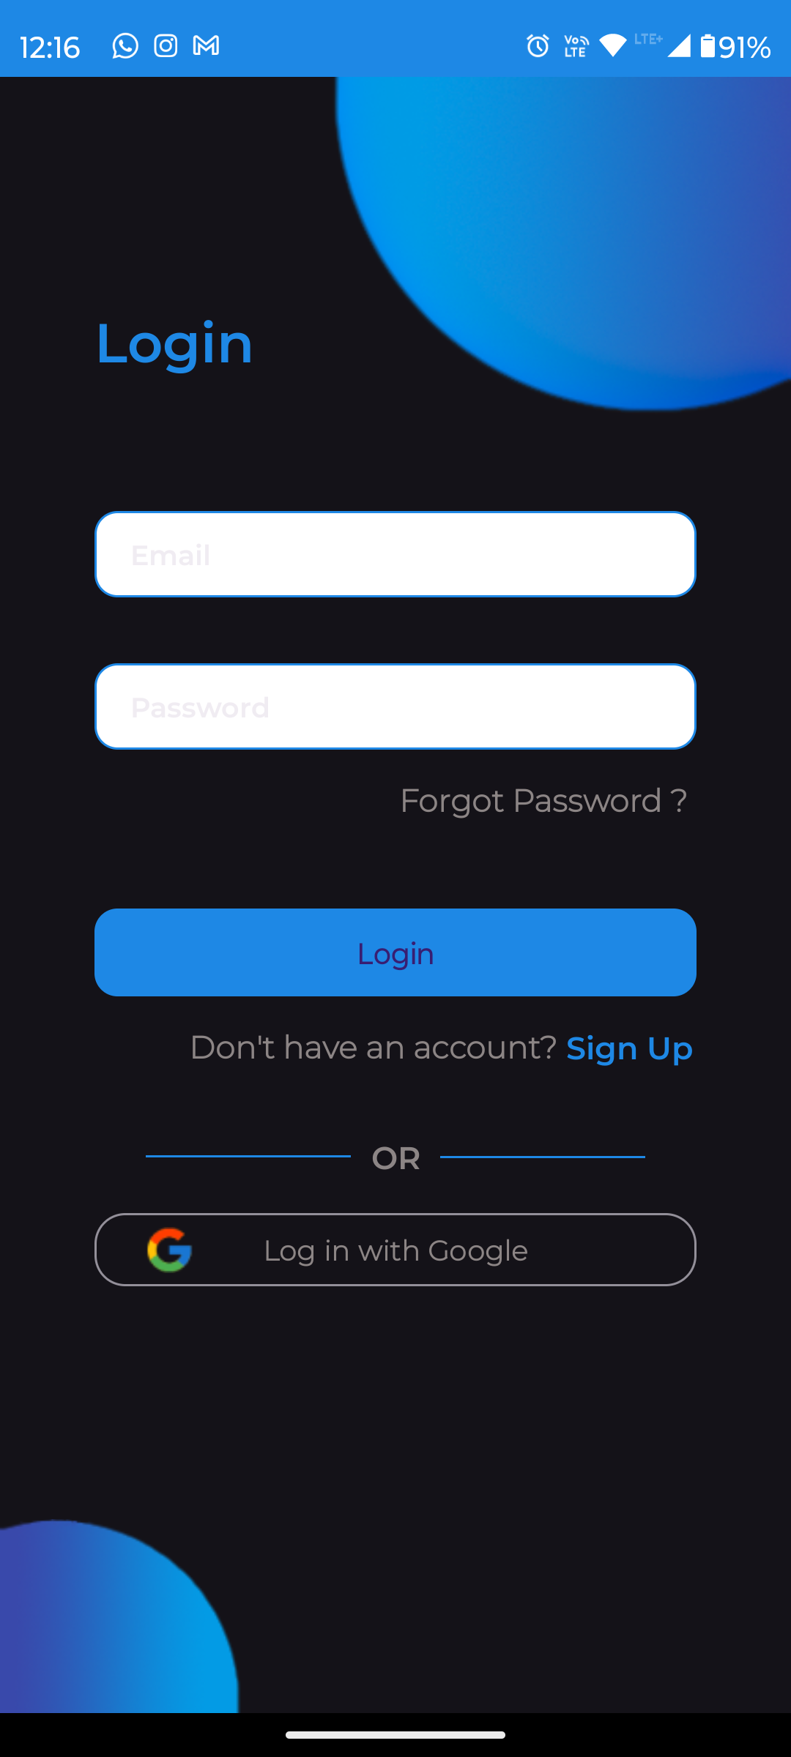
APPLICATION FLOW

Slide 15
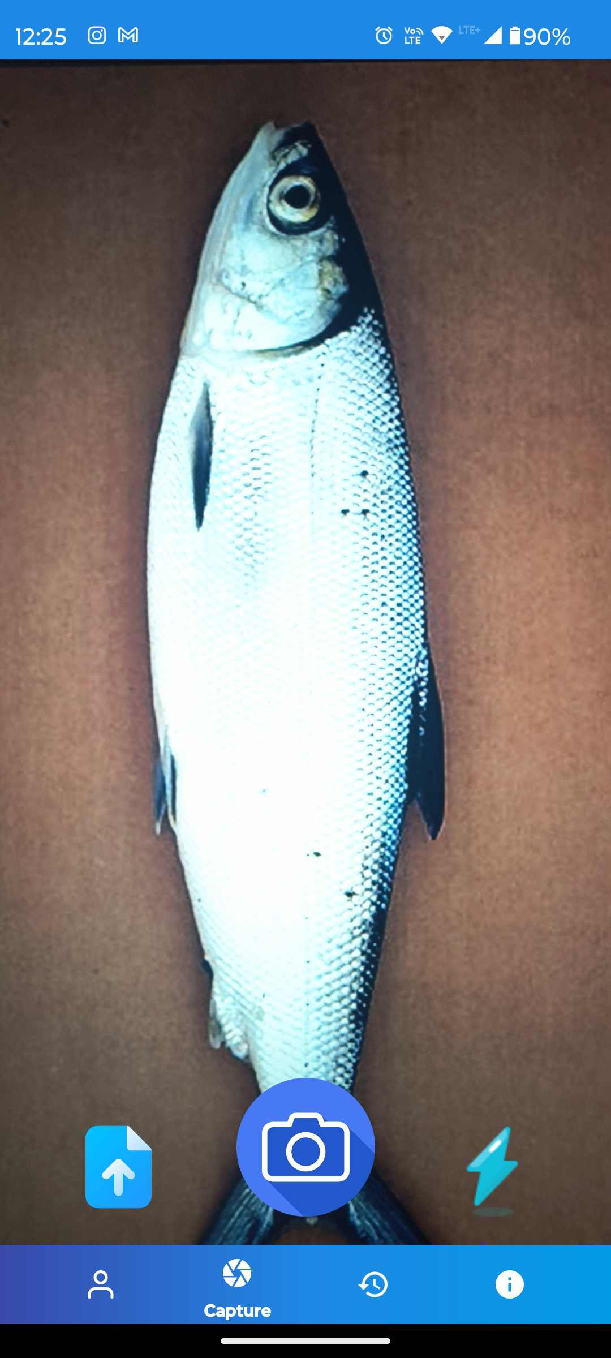
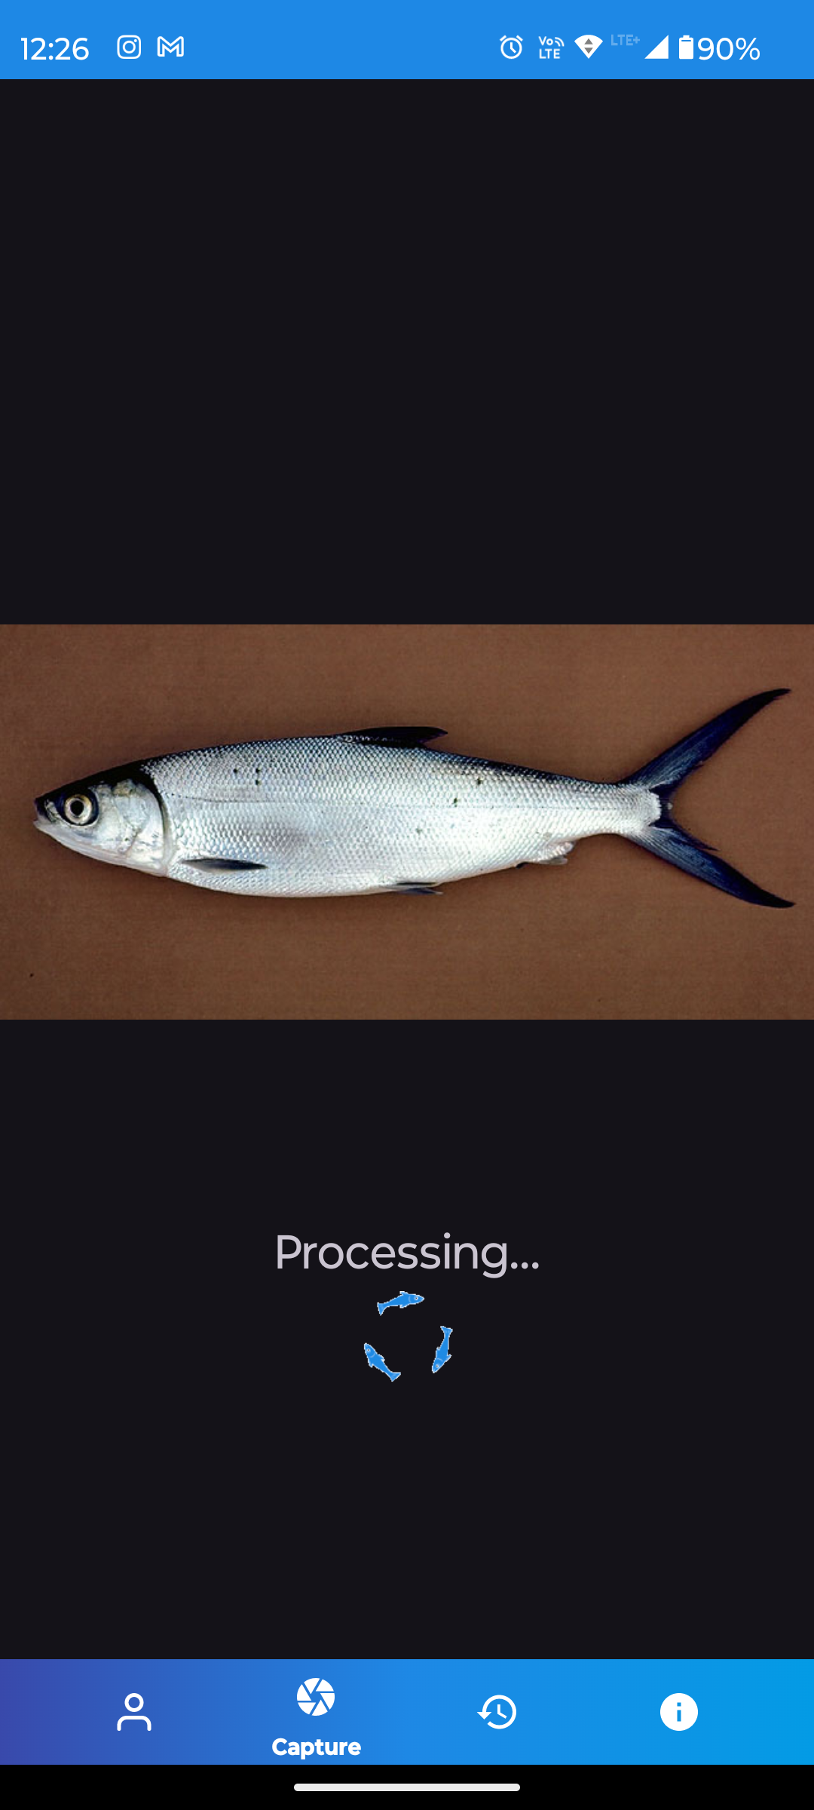
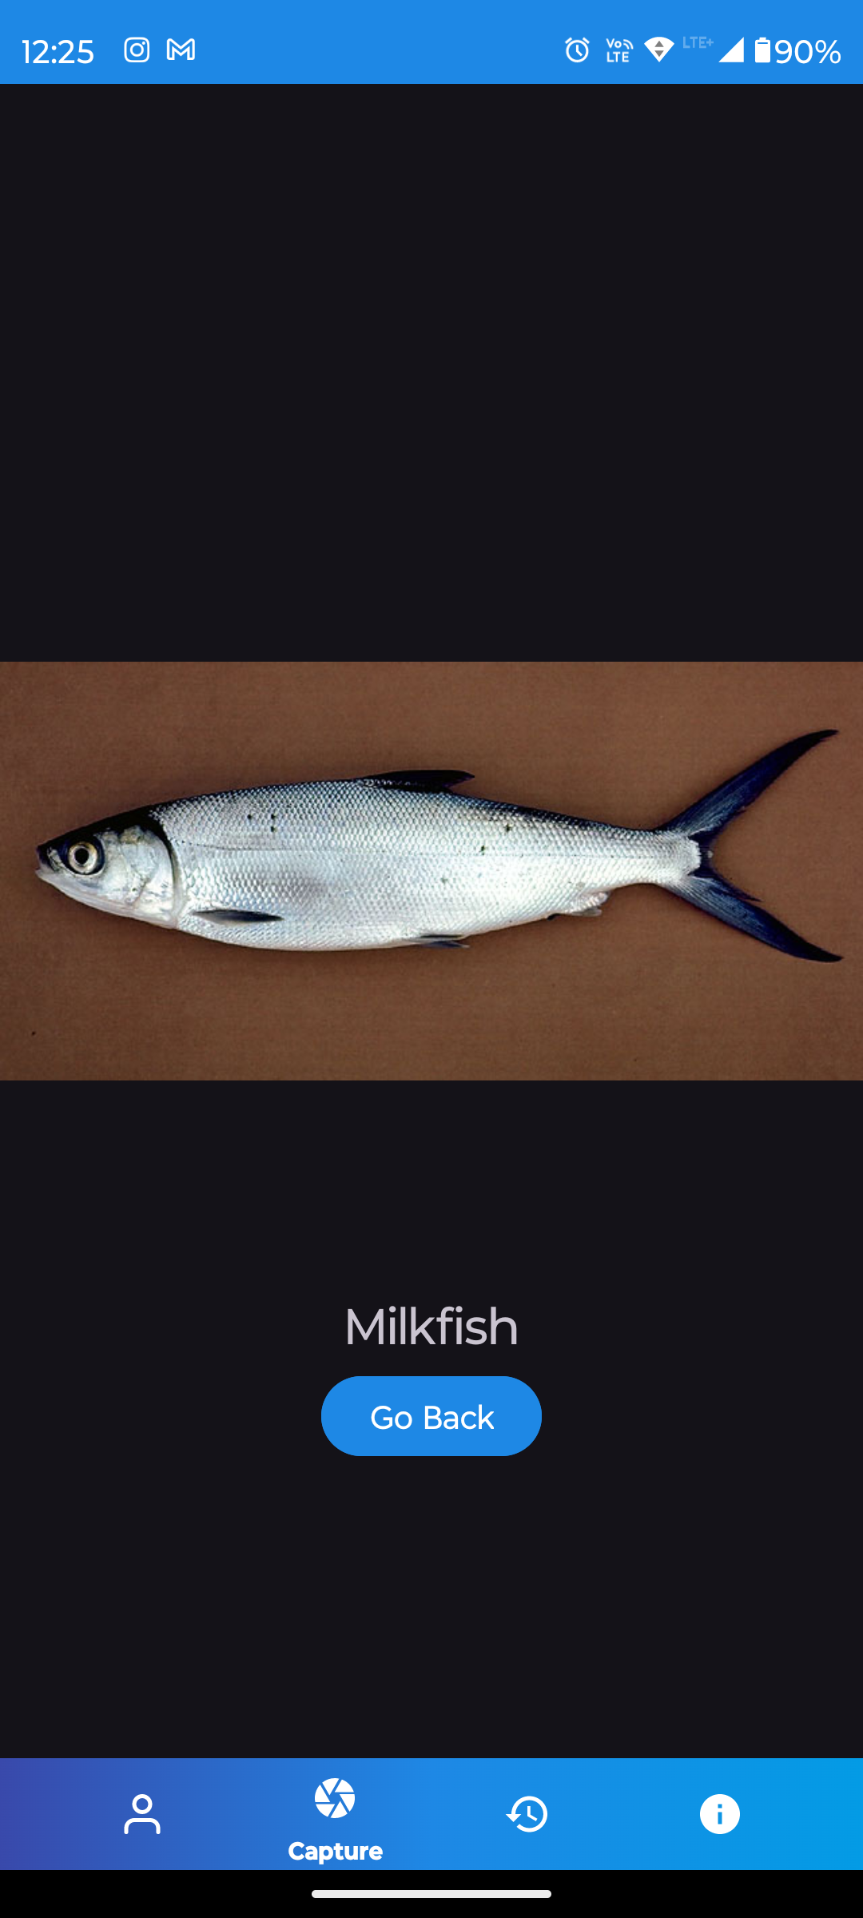
APPLICATION FLOW

Slide 16
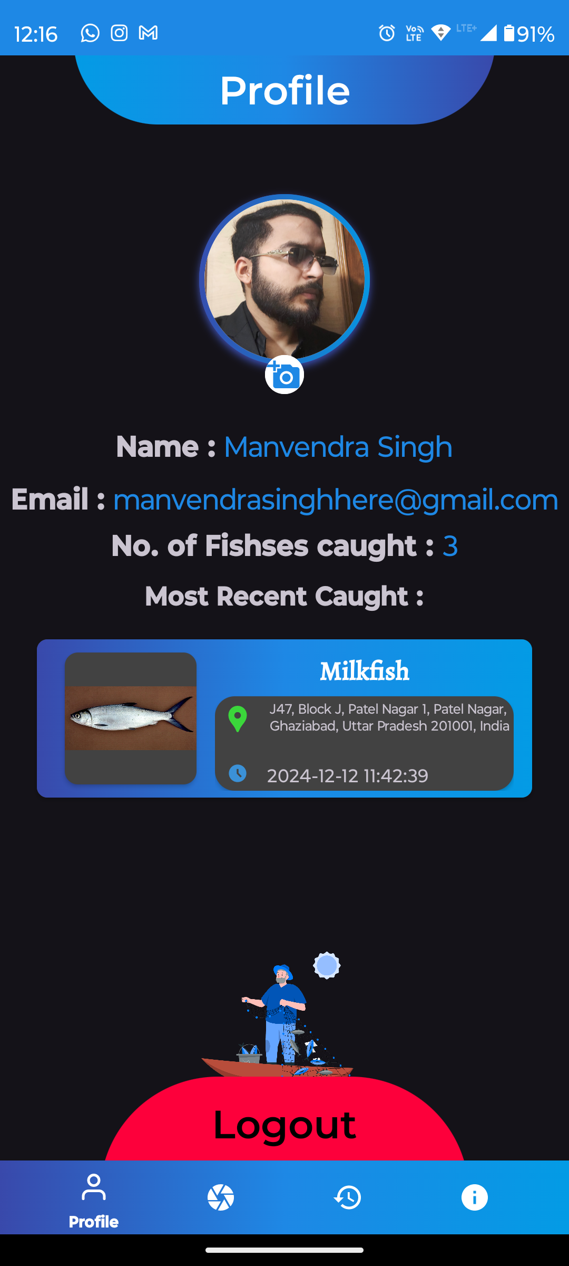
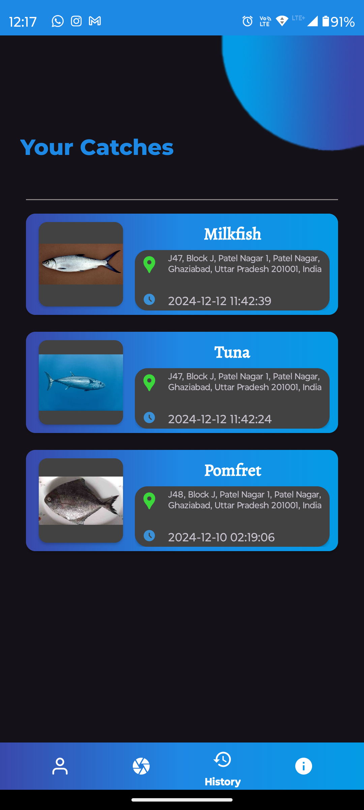
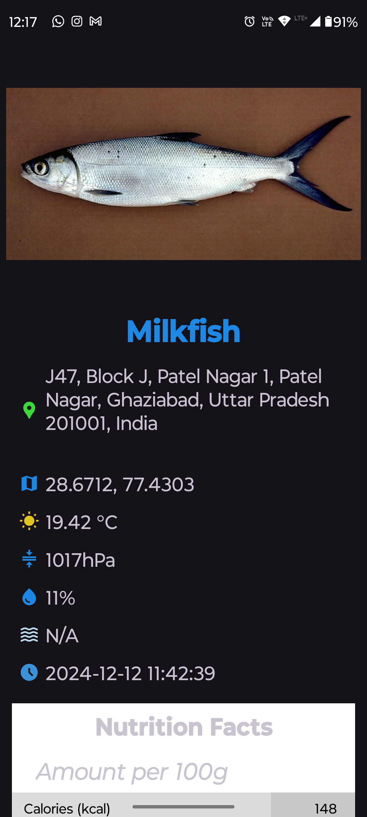
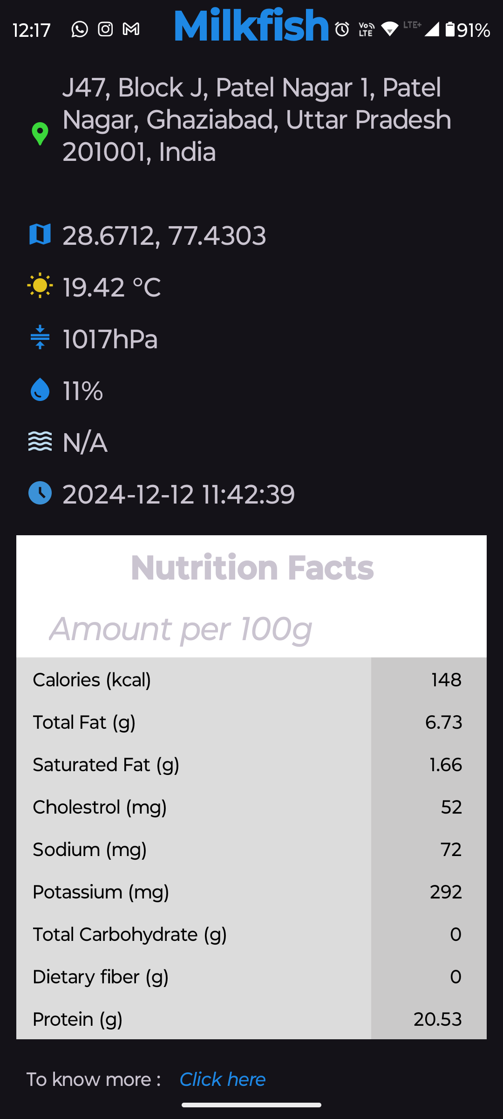
APPLICATION FLOW

Slide 17

Source : Thank You Sticker by AquaTots

